Slide 1
Java Collections

Slide 2
Java Collections
Collection vs collection
Operations
Interface and Class Hierarchy
Autoboxing
Sorting
Common Exceptions
Best Practices

Slide 3
Collection vs collection
Collection vs collection
There are three overloaded uses of the word “collection”:
collection (lowercase c), which represents any of the data structures in which objects are stored and iterated over
Collection (capital C), which is actually the java.util.Collection interface from which Set, List, and Queue extend
Collections (capital C and ends with s) is the java.util.Collections class that holds a pile of static utility methods for use with collections

Slide 4
Operations
Operations that can be done on a collection:
Add objects to the collection
Remove objects from the collection
Find out if an object (or group of objects) is in the collection
Retrieve an object from the collection (without removing it)
Iterate through the collection, looking at each element (object) one after another

Slide 5
Overriding equals()
Use @Override when overriding a method!
public boolean equals(Object o)
If the equals() method of a class is not overridden:
it will be used the one from Object class which uses == operator for comparison
those objects won’t be used as key in a map
won’t be created accurate Sets
The equals() contract:
it is reflexive - for any reference value x, x.equals(x) should return true
it is symmetric - for any reference values x and y, x.equals(y) should return true if and only if y.equals(x) returns true
it is transitive - for any reference values x, y, and z, if x.equals(y) returns true and y.equals(z) returns true, then x.equals(z) must return true
it is consistent - for any reference values x and y, multiple invocations of x.equals(y) consistently return true or consistently return false, provided no information used in equals comparisons on the object is modified
for any non-null reference value x, x.equals(null) should return false
Notes:
++ gove examples of bad overridings

Slide 6
Overriding hashCode()
public int hashCode()
If two objects are considered equal, their hashcodes must also be equal!
If the hashCode() method of a class is not overridden:
it will be used the one from Object class which always comes up with a unique number for each object, even if the equals() method is overridden in such a way that two or more objects are considered equal
the object in a collection won’t be found unless the same reference to the object is given
The hashCode() contract:
whenever it is invoked on the same object more than once during an execution of a Java application, the hashCode() method must consistently return the same integer, provided no information used in equals() comparisons on the object is modified
if two objects are equal according to the equals(Object) method, then calling the hashCode() method on each of the two objects must produce the same integer result
it is NOT required that if two objects are unequal according to the equals(java.lang.Object) method, then calling the hashCode() method on each of the two objects must produce distinct integer results; however, producing distinct integer results for unequal objects may improve the performance of Maps

Slide 7
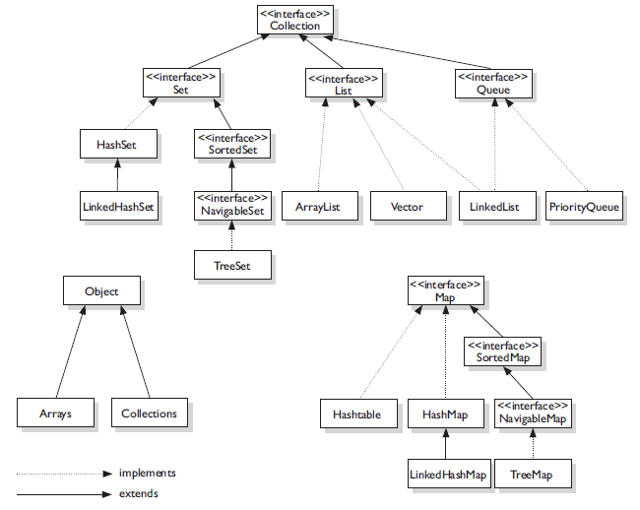
Hierarchy - Key Interfaces and Classes

Slide 8
Types of Collections
There are 4 types of collections:
Lists
lists of things (classes that implement List)
duplicates are allowed
Sets
unique things (classes that implement Set)
no duplicates are allowed
Maps
things with an unique ID (classes that implement Map)
Queues
things arranged by the order in which they are to be processed

Slide 9
Sub-types of Collections
There are sub-types of the collections types:
Ordered
we can iterate through the collection in a specific (not-random) order
Unordered
Sorted
ordered collection, the order in the collection is determined according to some rule or rules, known as the sort order
sorting is done based on properties of the objects themselves
you put objects into the collection and the collection will figure out what order to put them in, based on the sort order
Unsorted
An implementation class can be:
unsorted and unordered
ordered but unsorted, or
both ordered and sorted
An implementation can NEVER be sorted but unordered !

Slide 10
List Interface
List interface:
a List relies on the index
the one thing that List has that non-lists don't have is a set of methods related to the index
get(int index), indexOf(Object o), add(int index, Object obj) etc.
Classes that implement List interface:
ArrayList
fast iteration and fast random access
as of version 1.4, ArrayList implements the RandomAccess interface
it is an ordered collection (by index), but not sorted
Vector
it is basically the same as an ArrayList, but Vector methods are synchronized for thread safety
Vector is the only class other than ArrayList to implement RandomAccess
LinkedList
a LinkedList is ordered by index position, like ArrayList, except that the elements are doubly-linked to one another
this linkage gives methods for adding and removing from the beginning or end
as of Java 5, the LinkedList class has been enhanced to implement the java.util.Queue interface
it supports the common queue methods: peek(), poll() and offer()
Notes:
A list should implement the RandomAccess interface when the List#get(int) method has a constant asymptotic running time! (Written as O(1) in Big O Notation).
Consider an ArrayList: The data internally stored in an array. Calling arrayList.get(1) will take the same time as calling arrayList.get(100000).
In contrast to that: A LinkedList does not offer RandomAccess. While you can still call linkedList.get(1) and linkedList.get(100000), the latter will take much longer, because it has to traverse the whole list until it reaches the 100000th element.
shareimprove this answer

Slide 11
Set Interface
Set Interface
a Set relies on uniqueness
the equals() method determines whether two objects are identical
Classes that implement Set interface:
HashSet
it uses the hashcode of the object being inserted
it is unsorted, unordered
use this class when you want a collection with no duplicates and you don't care about order when you iterate through it
LinkedHashSet
it is an ordered version of HashSet that maintains a doubly-linked List across all elements
maintains insertion order
TreeSet
the TreeSet is one of two sorted collections
it guarantees that the elements will be in ascending order, according to natural order
as of Java 6, TreeSet implements NavigableSet

Slide 12
Map Interface
Map Interface
a Map relies on unique identifiers
a unique key (the ID) is mapped to a specific value
the equals() method determines whether two objects are identical
Classes that implement Map interface:
HashMap
it is an unsorted, unordered Map
allows one null key and multiple null values
Hashtable
it is the synchronized counterpart to HashMap
doesn't allow null keys or null values
LinkedHashMap
maintains insertion order of keys (default ) or access order
faster iteration
TreeMap
it is a sorted Map
as of Java 6, TreeMap implements NavigableMap

Slide 13
Queue Interface
Queue Interface
a Queue is designed to hold a list of "to-dos," or things to be processed in some way
queues are typically thought of as FIFO (first-in, first-out), but other orders are possible as well
supports all of the standard Collection methods
has methods to add and subtract elements and review queue elements
Classes that implement Queue interface:
PriorityQueue
introduced in Java 5
the purpose of a PriorityQueue is to create a "priority-in, priority out” queue as opposed to a typical FIFO queue
the elements' ordering represents their relative priority

Slide 14
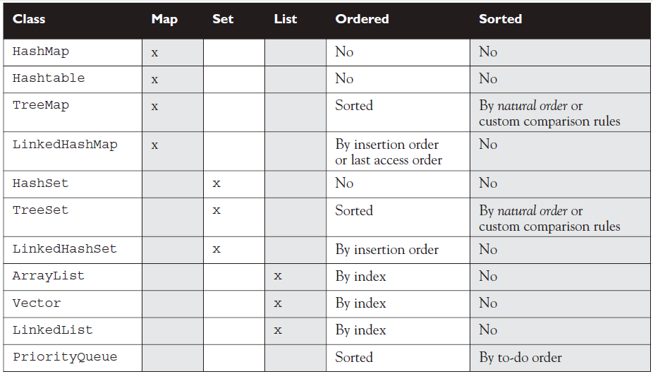
Concrete Classes – Overview

Slide 15
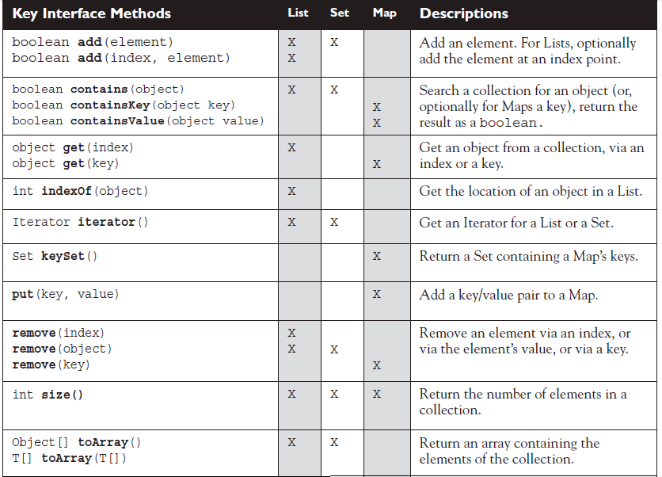
Key Methods in List, Set, and Map

Slide 16


Traversing Collections
for-each Construct
Iterator
For traversing a collection without modifying it, there is no difference between them!

Slide 17
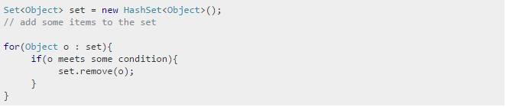
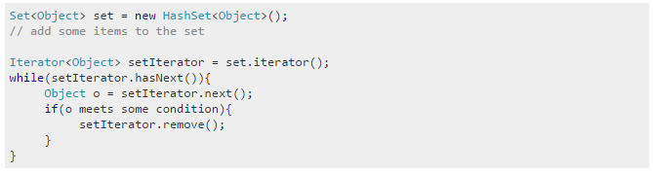
Traversing Collections
for-each Construct
- throws ConcurrentModificationException
Iterator
Notes:
56down vote
The difference isn't in performance, but in capability. When using a reference directly you have more power over explicitly using a type of iterator (e.g. List.iterator() vs. List.listIterator(), although in most cases they return the same implementation). You also have the ability to reference the Iterator in your loop. This allows you to do things like remove items from your collection without getting a ConcurrentModificationException.

Slide 18
Traversing Collections
for-each Construct
Iterator
Iterator.remove is the only safe way to modify a collection during iteration; the behavior is unspecified if the underlying collection is modified in any other way while the iteration is in progress.
Notes:
56down vote
The difference isn't in performance, but in capability. When using a reference directly you have more power over explicitly using a type of iterator (e.g. List.iterator() vs. List.listIterator(), although in most cases they return the same implementation). You also have the ability to reference the Iterator in your loop. This allows you to do things like remove items from your collection without getting a ConcurrentModificationException.

Slide 19
Useful Methods
Collections
make any collection object immutable by enclosing it in an unchangeable wrapper
Set immutableSet = Collections.unmodifiableSet(mySet);
this essentially wraps the object in another object where the modification methods such as add() and remove() have been overridden so that they throw an UnsupportedOperationException
most Collection classes are by default not synchronized
you can make any Collection object synchronized by enclosing it in an synchronized wrapper
Map threadSafeMap = Collections.synchronizedMap(myMap);
this essentially wraps the object in another object where methods have been overridden so that they are all synchronized
this is useful when seeking a synchronized Map class that behaves like a Hashtable (which is synchronized while classes like HashMap are not)

Slide 20
Autoboxing with Collections
Collections can hold Objects but not primitives
prior to Java 5, a primitive had to be manually wrapped in its corresponding wrapper class before you could put it into a collection
starting with Java 5, primitives still have to be wrapped, but autoboxing takes care of it for you
Pre Java 5:
List myInts = new ArrayList();
myInts.add(new Integer(42));
Starting with Java 5:
myInts.add(42);

Slide 21
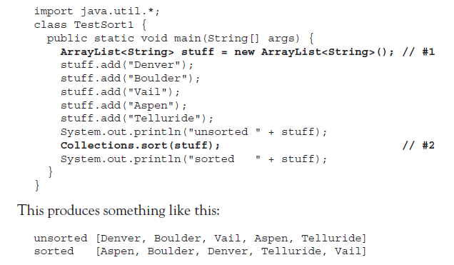
Sorting

Slide 22
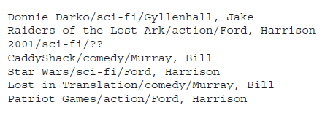
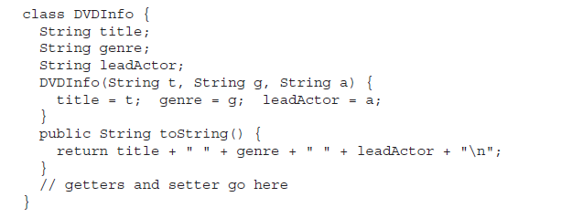

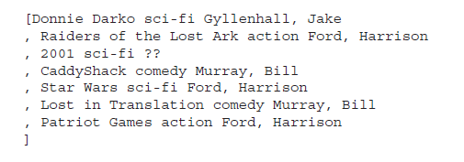
Sorting

Slide 23
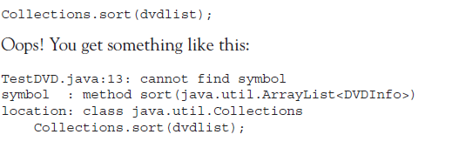
Sorting

Slide 24
Sorting
Collections.sort(List<T> list)
it uses the natural order of the elements for sorting
an exception is thrown when trying to sort elements of class that doesn’t have defined the natural order
to define a sorting order, a class can implement the Comparable interface
Collections.sort(List<T> list, Comparator<? super T> c)
sorts the specified list according to the order induced by the specified comparator
the Comparator interface gives you the capability to sort a given collection any number of different ways

Slide 25
Sorting
The Comparable Interface
defines the natural order
to implement Comparable, a class must implement a single method, compareTo()
compareTo() method returns:
a negative integer - this object is less than the specified object
zero - this object is equal to the specified object
a positive integer - this object is greater than the specified object

Slide 26
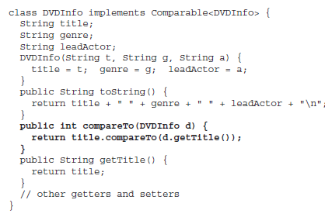
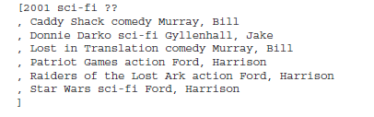
Sorting

Slide 27
Sorting
Sorting with Comparator
Comparator gives the capability to sort a given collection any number of different ways
you can use it to sort instances of any class, even classes you can't modify
it is also very easy to implement, having only one method, compare()
compare() method returns:
a negative integer – first object is less than the second object
zero – first object is equal to the second object
a positive integer – first object is greater than the second object

Slide 28
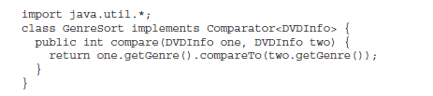
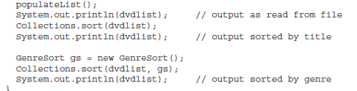
Sorting
The Comparator Interface

Slide 29
Common Exceptions - Collections
java.lang.ClassCastException
all elements in the list must implement the Comparable interface and must be mutually comparable
java.lang.UnsupportedOperationException
thrown to indicate that the requested operation (add, remove) is not supported by the immutable collection object
java.util.ConcurrentModificationException
this exception appears either in a multithreading context if the collection object has been concurrently modified by a different thread while another thread is iterating over the collection
or it can also appear in a single threaded context when a thread modifies a collection object directly while it is iterating it
fail-fast iterators will throw this exception when this behaviour is detected

Slide 30
Best Practices - Collections
Best Practices
choose the right type of collection based on the need:
if we need access based on the index, we might want to use ArrayList
if we have to iterate over the Map in order of insertion, we need to use LinkedHashMap
if we don’t want duplicates, we should use a HashSet
write programs in terms of interfaces not implementations, it allows to change the implementation easily at a later point of time
prefer using lists over arrays
Object[] objectArray = new Long[1];
objectArray[0] = "I don't fit in"; //throws ArrayStoreException
List<Object> ol = new ArrayList<Long>(); //compilation failure - Incompatible types
ol.add("I don't fit in");

Slide 31
Best Practices - Collections
Best Practices
the for-each loop should be used with both collections and arrays since it is intended to simplify the most common form of iteration
it should be preferred over the for loop and iterators
while being used in a Map or Set, keys of a Map and items in a Set must not change state
hence, it is recommended that these items be immutable objects
use generic types and generic methods

Slide 32
Questions?

Slide 33


Thank you!
Andrei Closca
Developer
andrei.closca@endava.com
en_aclosca

